Slide 1
Brain Tumor Detection
Using Convolutional Neural Networks and Streamlit
Name Regd. No. CRANES Regd. No.
Anmol Chourasia 2201020184 CL2025010601915894
Aniket Kit 2201020013 CL202501060195575
Mohit Kumar Ghosh 2201020095 CL2025010601935963
Shivam Singh 2201020226 CL20250106019168104

Slide 2
Introduction
This presentation covers brain tumor detection utilizing AI technology, focusing on the implementation of convolutional neural networks and the development of a streamlined web application.
Brain tumors are life-threatening and require timely detection. Early diagnosis can significantly improve treatment outcomes and patient survival rates.
Manual diagnosis from MRI scans is time-consuming and prone to error. It depends heavily on the expertise of radiologists and may vary between professionals.
This project uses AI and Deep Learning to automate the detection process. The goal is to create a faster, more reliable diagnostic tool to assist healthcare professionals.

Slide 3
01
Overview

Slide 4
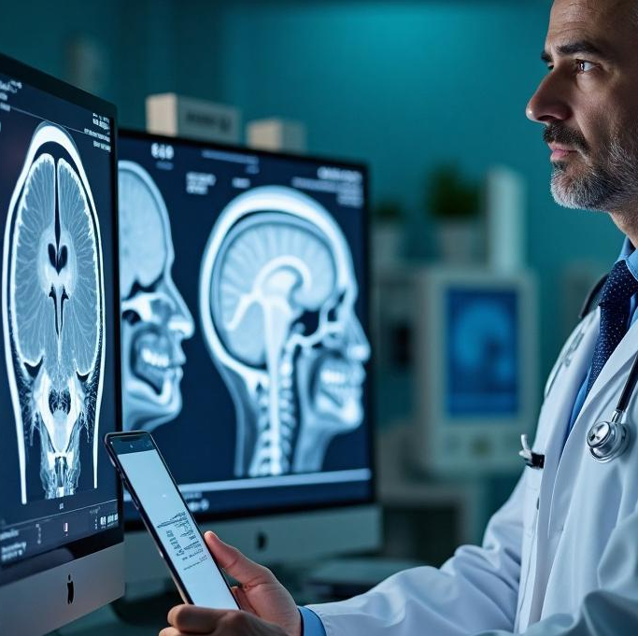
Medical significance of brain tumors.
Brain tumors are critical medical conditions that can affect neurological function and overall health. Early I dentification plays a vital role in improving patient outcomes and tailoring effective treatment strategies.
Importance of early detection.
Detecting brain tumors at an early stage can significantly enhance treatment efficacy. It allows for timely interventions, which can prevent further complications and improve survival rates.
AI in medical imaging.
Artificial Intelligence, particularly deep learning, enhances medical imaging analysis by automating the detection process, increasing accuracy, and providing consistency in interpreting MRI scans.

Slide 5
02
Objective

Slide 6
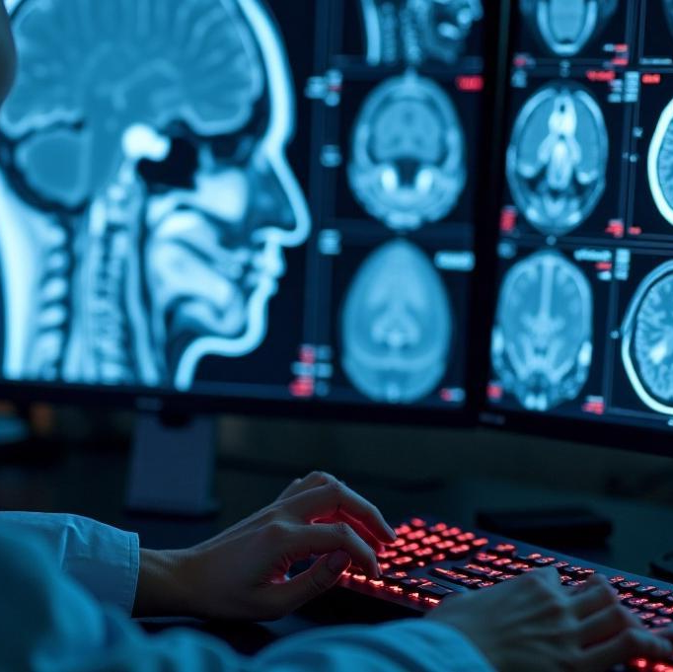
Deep learning model with CNN.
The primary objective is to develop a robust deep learning model leveraging Convolutional Neural Networks (CNN) to analyze MRI images for brain tumor detection.
User-friendly web app using Streamlit.
In addition to the model, a user-centric web application will be designed using Streamlit, facilitating easy interaction and access to predictions.
MRI image classification.
The system will classify MRI images into two categories: 'Healthy' and ‘Tumor,' aiding in rapid diagnosis and efficient treatment planning.

Slide 7
03
Dataset

Slide 8
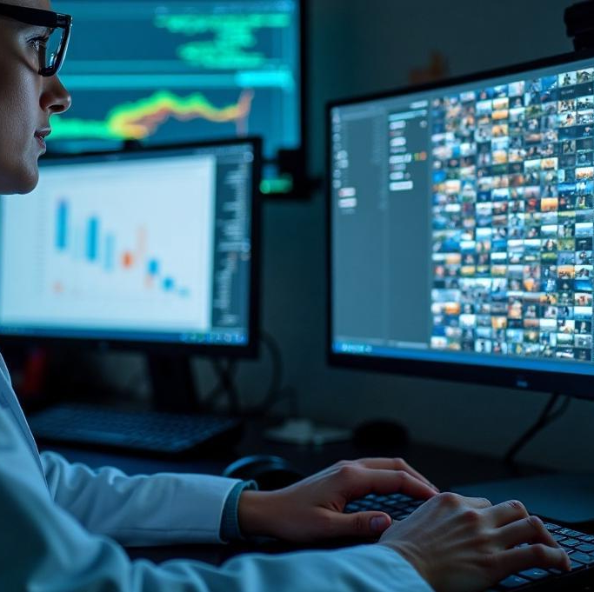
Dataset structure (Healthy, Tumor).
The dataset comprises MRI images categorized into 'Healthy' and 'Tumor,' providing diverse samples to train and validate the model's accuracy.
Source and format of MRI images.
MRI images are sourced from reputable medical databases, ensuring a wide variety of cases in standard formats suitable for processing.
Data preprocessing steps.
Preprocessing involves resizing all images to 64x64 pixels to standardize input, along with normalization to enhance model performance.

Slide 9
04
Model Architecture

Slide 10
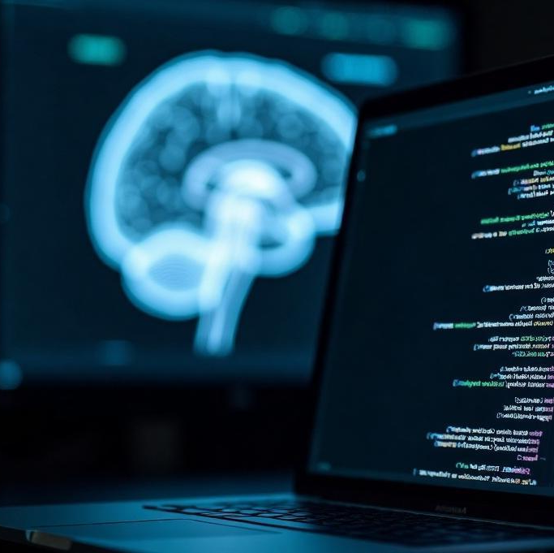
CNN layers used.
The CNN architecture includes layers such as Conv2D for feature extraction,MaxPooling2D for dimensionality reduction, and Dense layers for classification.
Activation functions.
ReLU (Rectified Linear Unit) is employed in hidden layers to introduce non-linearity, while Softmax is used in the output layer for multiclass classification.
Model compilation details.
The model is compiled using the Adam optimizer, which adapts the learning rate for efficient training. Categorical crossentropy is employed as the loss function to quantify the difference between predicted and actual labels, making it suitable for multiclass classification tasks.

Slide 11
05
Training & Evaluation

Slide 12
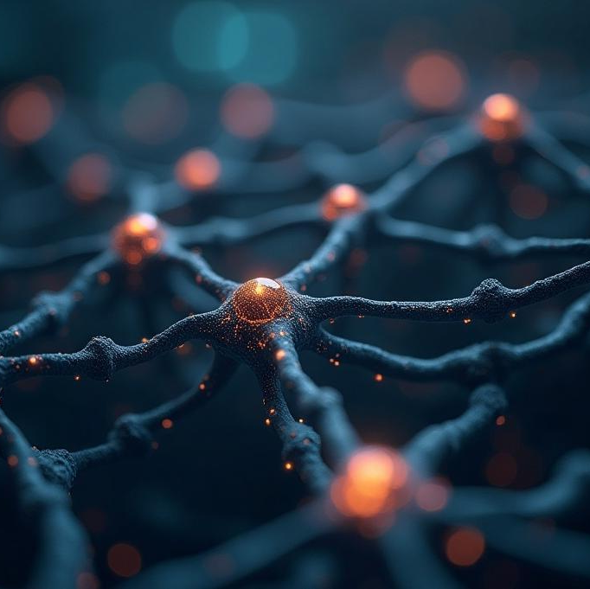
Training configuration
The model is trained for 10 epochs with a validation split to monitor its performance on unseen data. This configuration helps fine-tune the model and prevents overfitting.
Validation accuracy
On validation data, the model achieved an accuracy of X% (insert specific value), demonstrating its capability to accurately classify brain MRI images and suggesting effectiveness in real-world applications.
Dropout to combat overfitting
Dropout layers are integrated within the model to mitigate overfitting by randomly setting a portion of the neurons to zero during training, promoting a more generalized model that performs better on unseen data.

Slide 13
06
Web Application

Slide 14
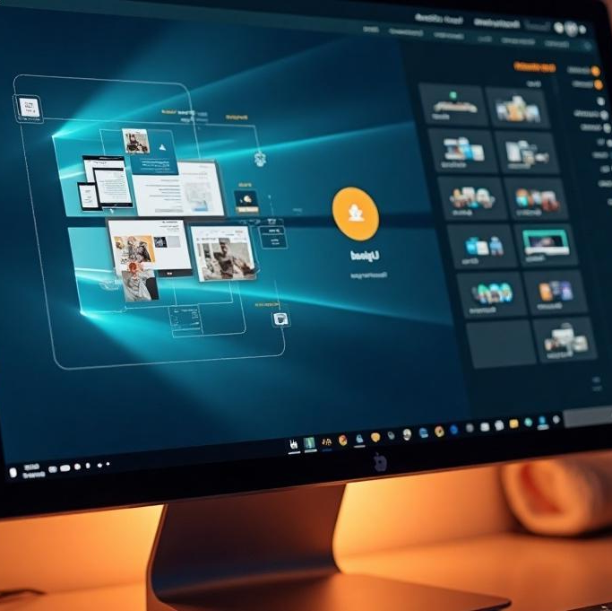
User interface design.
The user interface of the Streamlit application is designed for simplicity, featuring an intuitive file uploader for users to input MRI images, an image preview area, and a clear prediction button.
Model integration in app.
The deep learning model is seamlessly integrated into the Streamlit app, allowing users to receive instant feedback on the classification results upon uploading their MRI images.
Real-time prediction benefits.
The app offers real-time predictions, significantly enhancing the user experience by providing fast and accurate assessments of MRI images, thus supporting timely medical decisions.

Slide 15
07
Challenges & Learnings

Slide 16
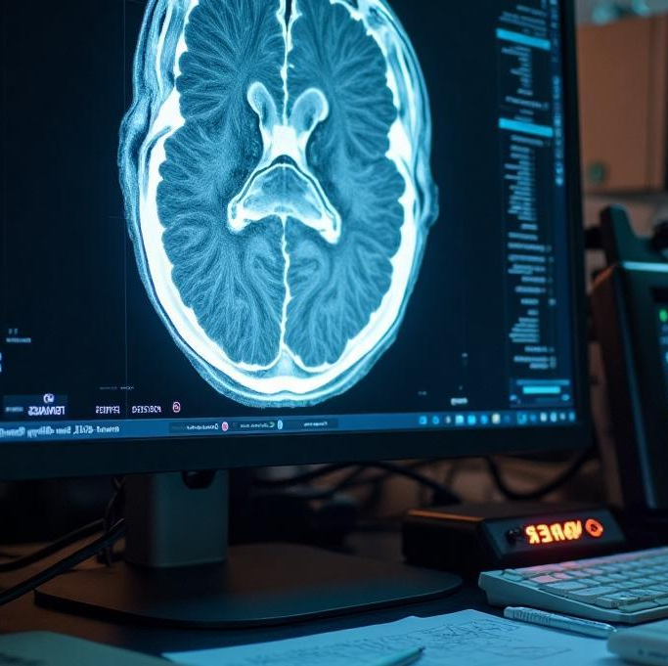
Issues in training and deployment
Challenges encountered during training included balancing the dataset and optimizing hyperparameters. Deployment issues revolved around ensuring model accessibility and user interface responsiveness.
Importance of preprocessing
Preprocessing steps were critical for attaining high model accuracy. Properly normed images and standardized sizes contributed to the model's learning capacity and overall performance.
Skills developed in deep learning
The project fostered skills in deep learning, model evaluation, and web application development, enriching the understanding of neural networks and their practical implementations.

Slide 17
08
Future Scope

Slide 18
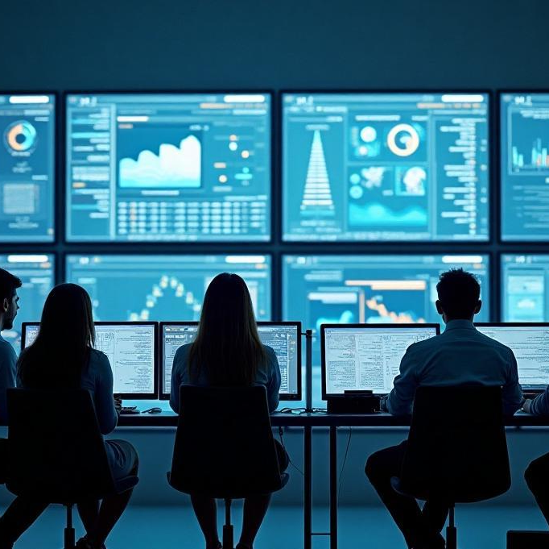
Enhancing model with larger datasets
Future work will focus on sourcing and utilizing larger and more diverse datasets to improve model robustness and accuracy across varied brain tumor types.
Implementing data augmentation
Data augmentation techniques will be applied to artificially increase the diversity of the training data, helping to improve model generalization and performance.
Mobile app deployment with TensorFlow Lite
Plans include deploying the model as a mobile application using TensorFlow Lite, enabling healthcare professionals to access tumor detection capabilities anywhere at any time.

Slide 19
09
conclusion

Slide 20
The project successfully demonstrated the feasibility of utilizing CNNs for brain tumor detection, fundamentally enhancing diagnostic capabilities in healthcare. The user-friendly web application provides a significant step towards integrating AI in medical practice, paving the way for future developments.
CNN successfully classifies MRI scans into healthy/tumor. The model meets its core objective.
Web app enables easy access to AI-powered diagnosis. Makes the tool practical and usable.
A step toward integrating AI in medical diagnostics. Demonstrates the potential of AI in healthcare.

Slide 21
Thank you!

